Slide 1



KBTG x MeowCode
Say “Hello”
Machine Learning
Jetsukda Janthornthao
AI Engineer @ Ztrus
x

Slide 2

What is Machine Learning (ML)
Main types of Machine Learning
Steps in a full ML project
Machine Learning Framework
Class Overview

Slide 3


1. What is Machine Learning (ML)
Train
Test
Data
Machine Learning
algorithm
Patterns
Prediction
Answer
Future
Data
Model
Patterns

Slide 4
Terminology about ML
Regression
Predicting a continuous output (e.g. price, sales).
Classification
Predicting a categorical output.
Feature
With respect to a dataset, a feature represents an attribute and value combination.
Label
In supervised learning, the "answer" or "result" portion of an example.

Slide 5
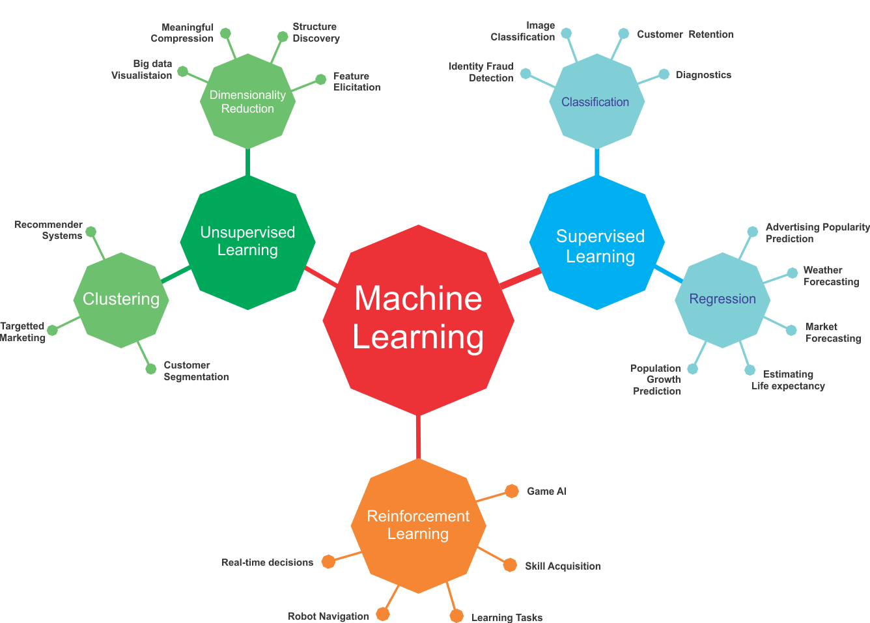
2. Main types of Machine Learning

Slide 6

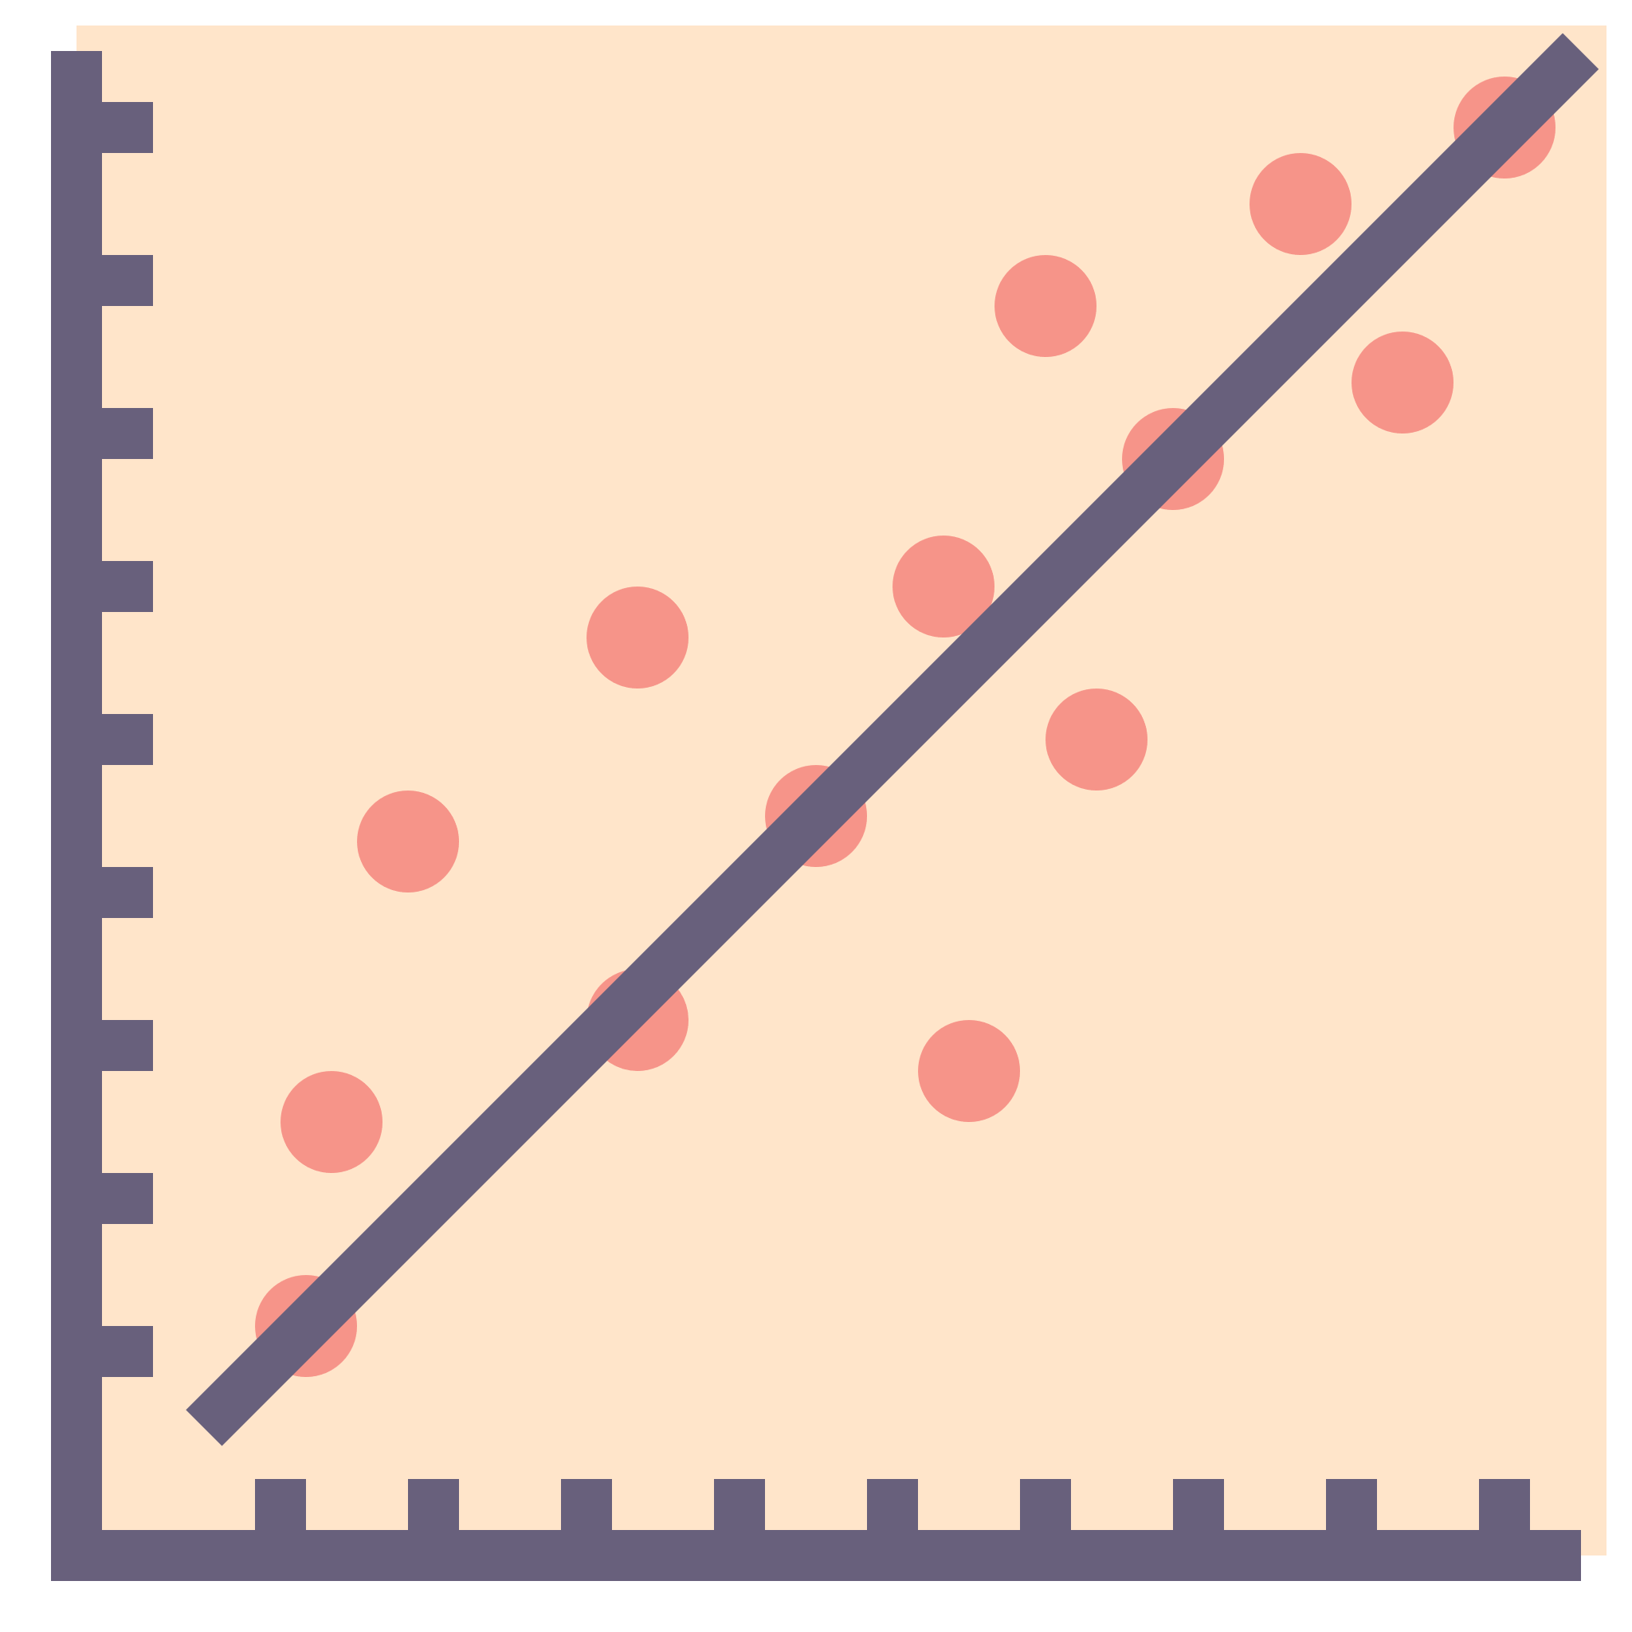
Supervised Learning
the training set you feed to the algorithm includes the desired solutions, called labels
Classification
Regression
Supervised Learning Algorithms
k-Nearest Neighbors
Linear Regression
Logistic Regression
Support Vector Machines (SVMs)
Decision Trees and Random Forests

Slide 7
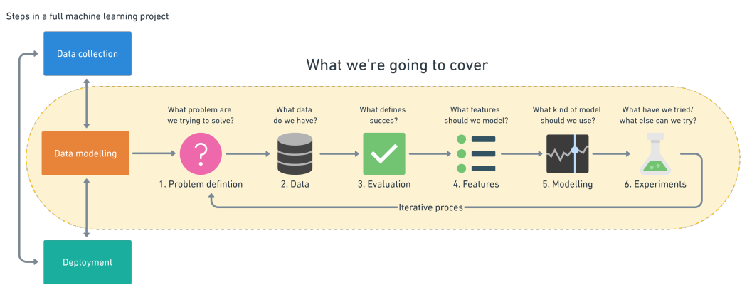
3. Steps in a full ML project

Slide 8
3.1 Problem definition

Slide 9
Supervised Learning
Classification
Binary classification
Email spam detection (spam or not).
Churn prediction (churn or not).
Multi-class classification
classify a set of images of fruits which may be oranges, apples, or pears.

Slide 10
1. Problem definition (Supervised Learning)
Supervised Learning
Regression
Predicting whether stock price of a company will increase tomorrow ?
How much will this house sell for ?
How many people will buy this app ?

Slide 11
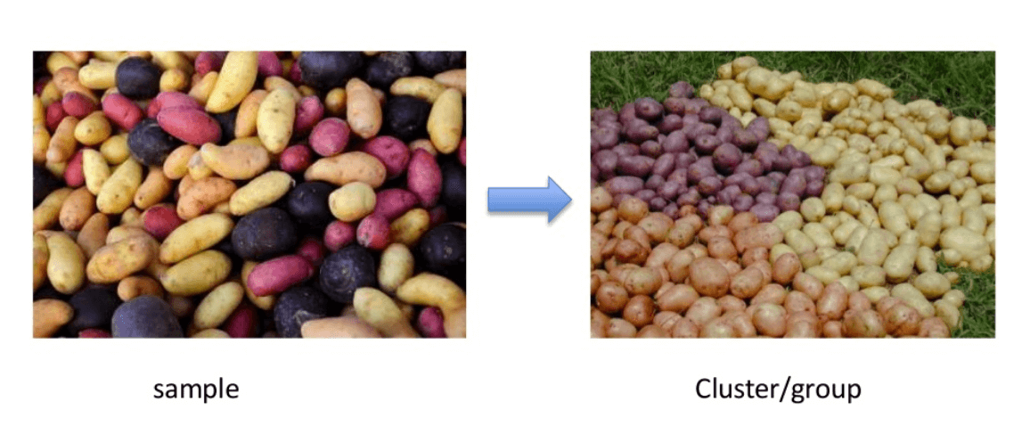
Unsupervised Learning
Clustering

Slide 12
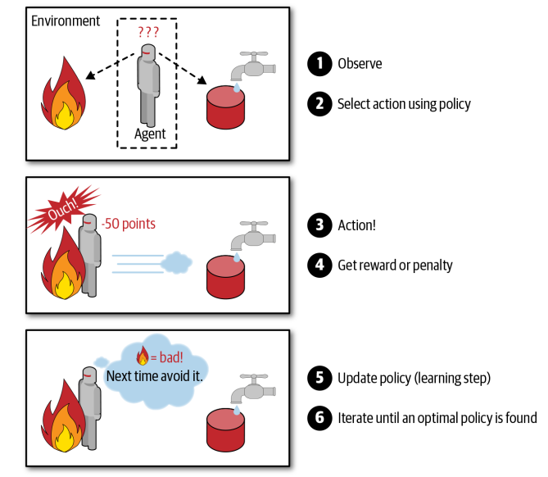
Reinforcement Learning

Slide 13

3.2 Data
What kind of data do we have ?

Slide 14
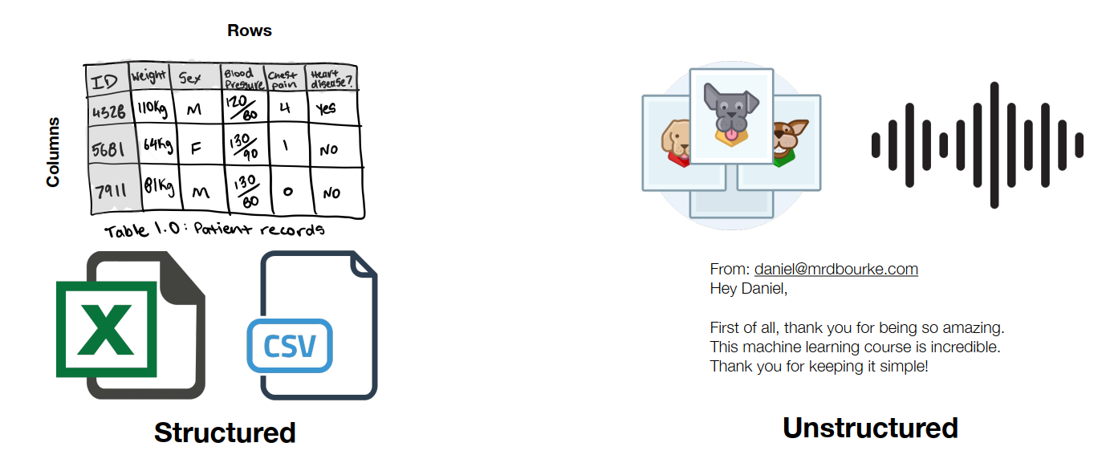
Different types of data

Slide 15

3.3 Evaluation
What defines success for us?

Slide 16
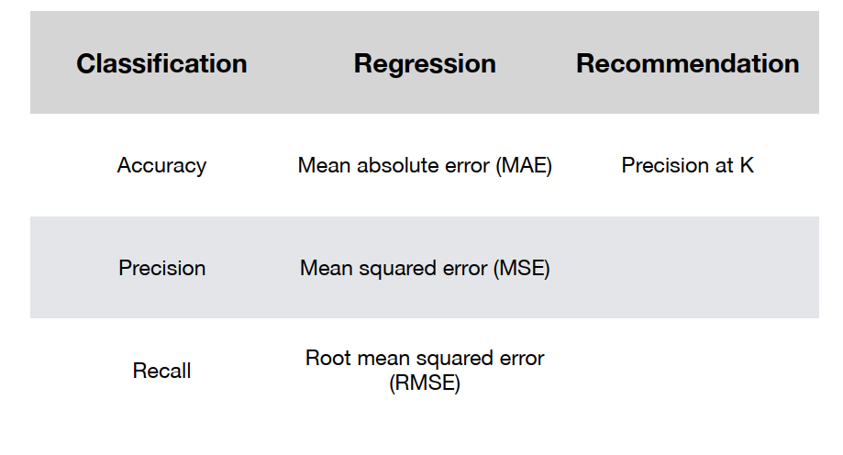
Different types of metrics

Slide 17

3.4 Features
What do we already know about the data?

Slide 18
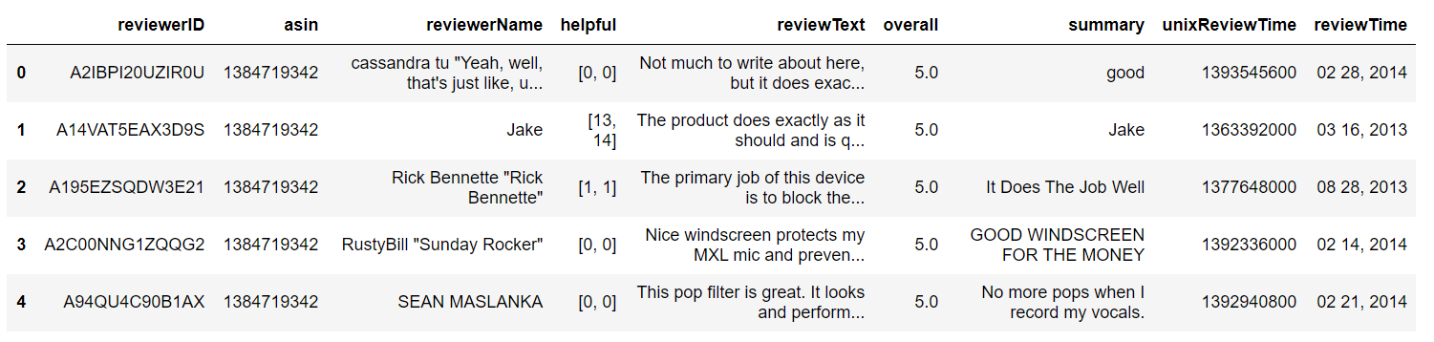
Different features of data
Categorical features
Numerical features

Slide 19
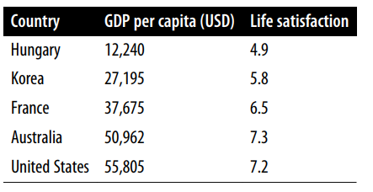
Different features of data
Categorical features
Numerical features

Slide 20
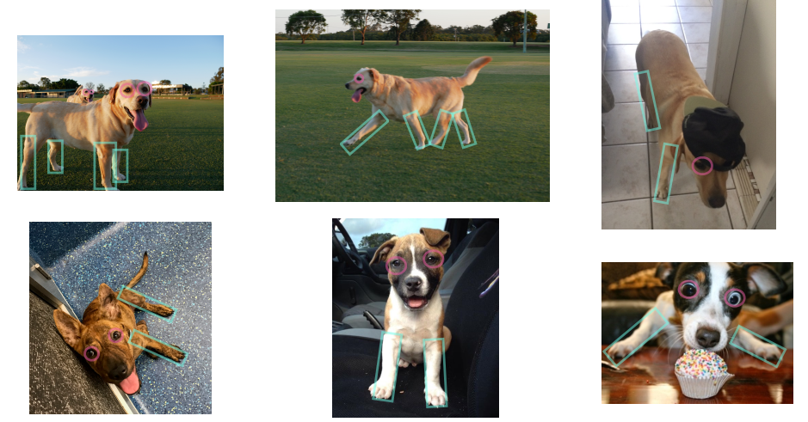
Different features of data

Slide 21

3.5 Modelling
Based on our problem and data, what model should we use?

Slide 22
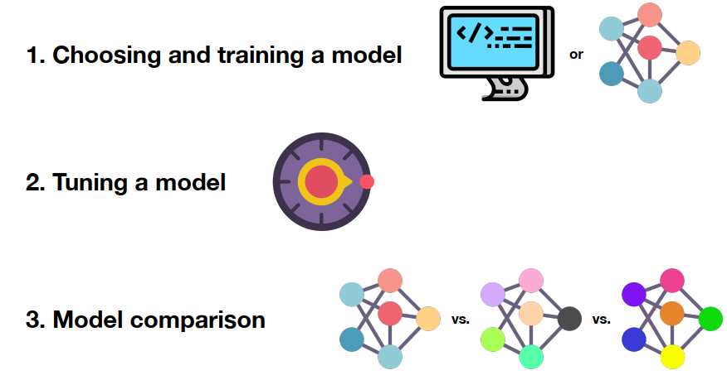
3 parts to modelling

Slide 23
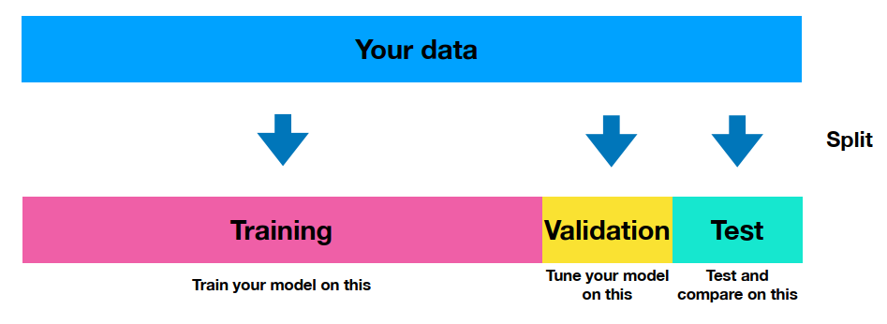
The most important concept in ML

Slide 24
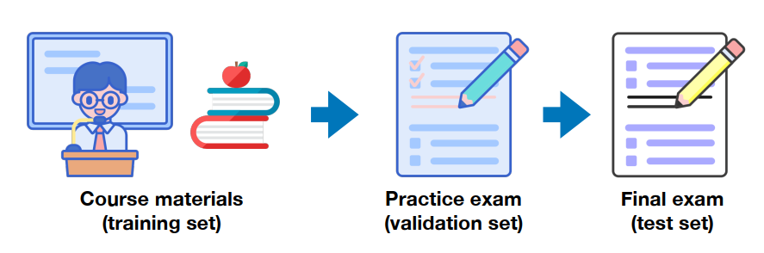
The most important concept in ML

Slide 25
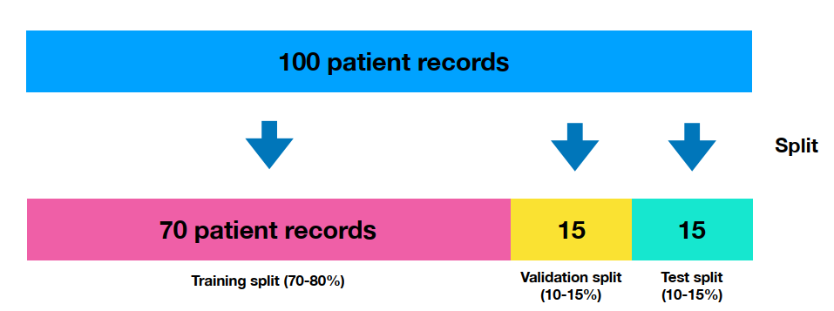
The most important concept in ML

Slide 26
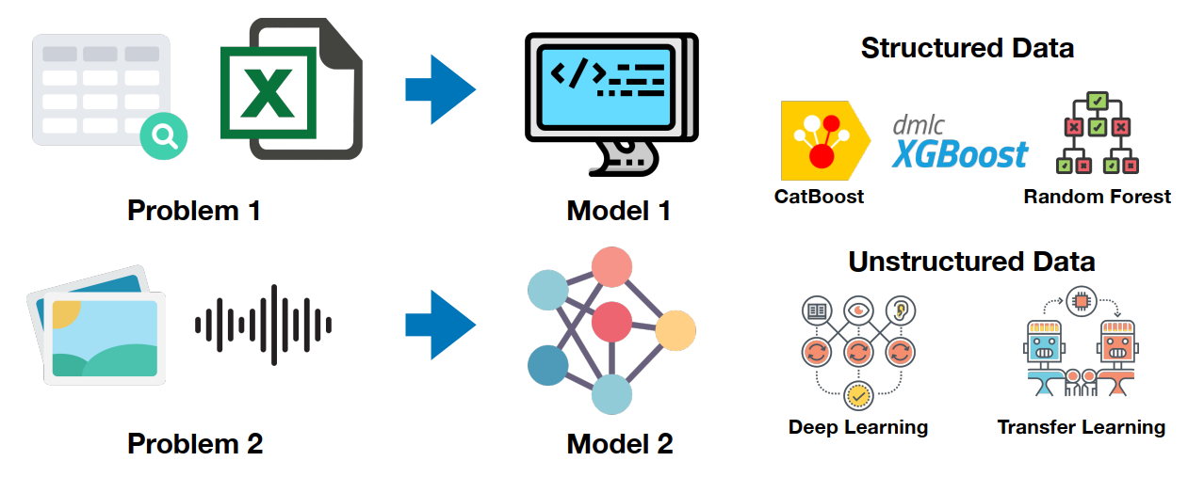
Choosing a model

Slide 27
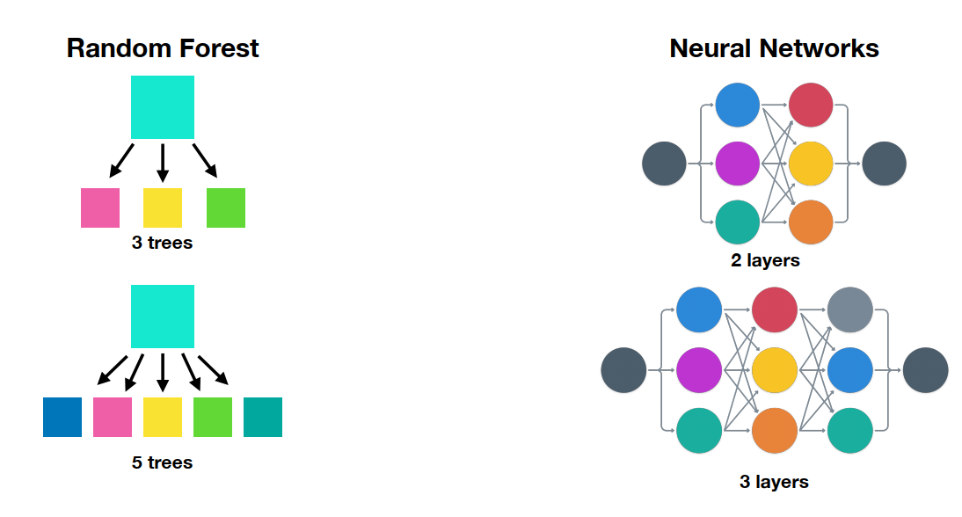
Tuning a model

Slide 28
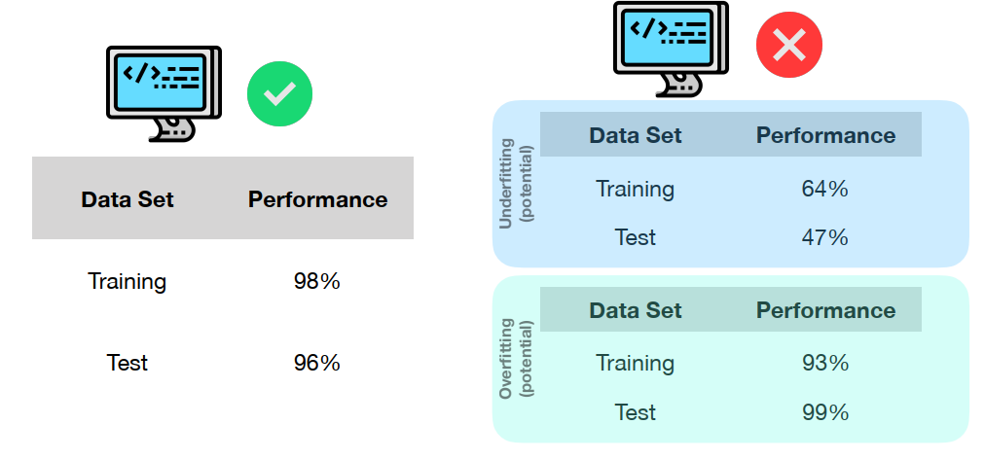
Testing a model

Slide 29
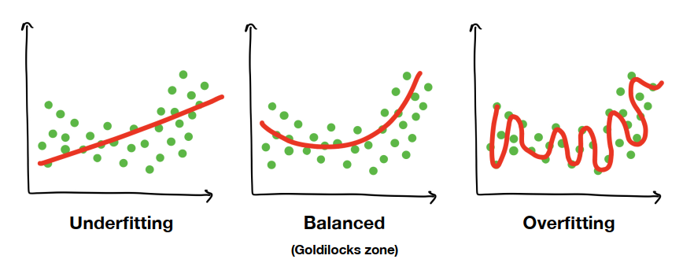
Overfitting and underfitting

Slide 30
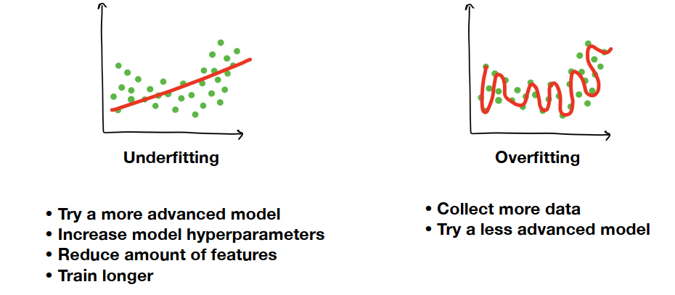
Fixes for overfitting and underfitting

Slide 31
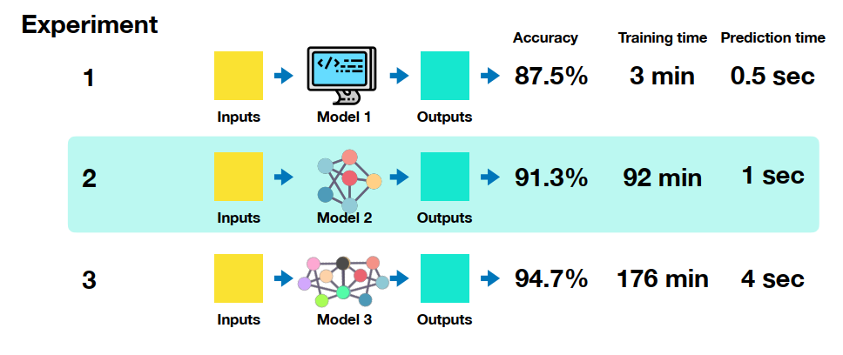
6. Experiments

Slide 32
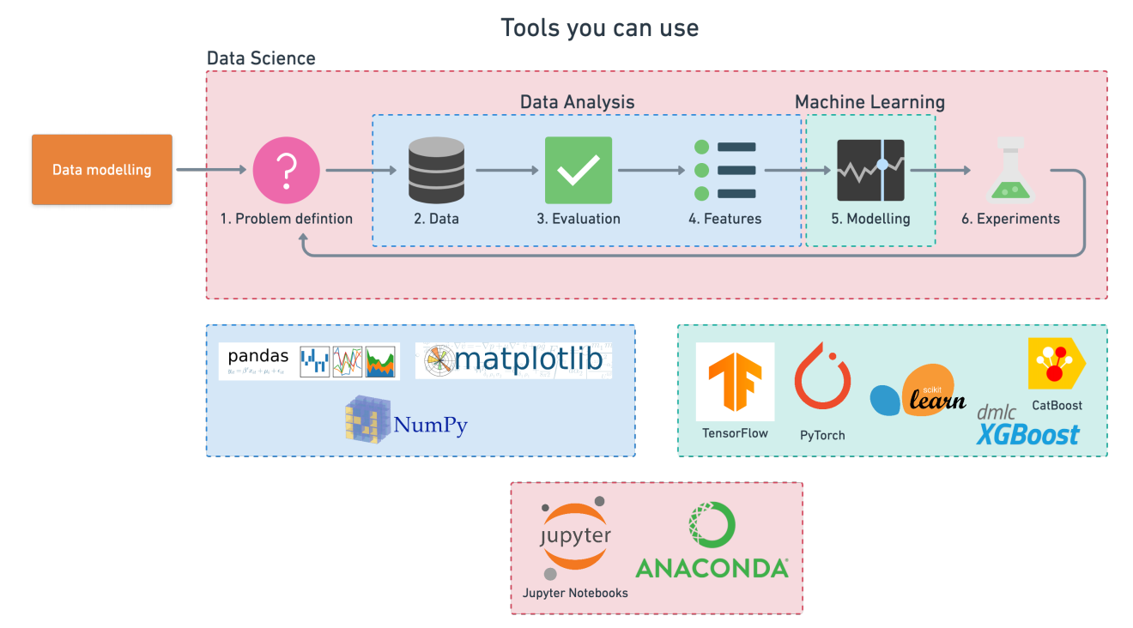
Machine Learning Framework

Slide 33

Scikit-Learn (sklearn)
Scikit-Learn is a python machine learning library.
Built on NumPy and Matplotlib (and Python).
Has many in-built machine learning models.
Methods to evaluate your machine learning models.
https://scikit-learn.org/stable/

Slide 34

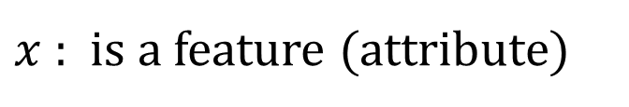
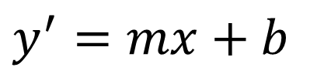
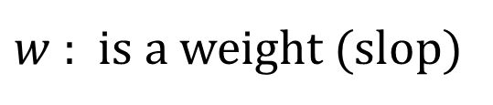
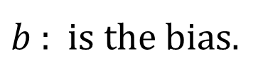
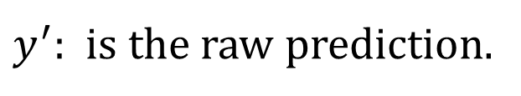
Linear model
$$y^{′}=mx+b$$
$y^{′}$: is the raw prediction.
$w$ : is a weight (slop)
$$y^{′}=w_{1}x_{1}+w_{2}x_{2}+…+w_{n}x_{n}+b$$
$x$ : is a feature (attribute)
$b$ : is the bias.

Slide 35
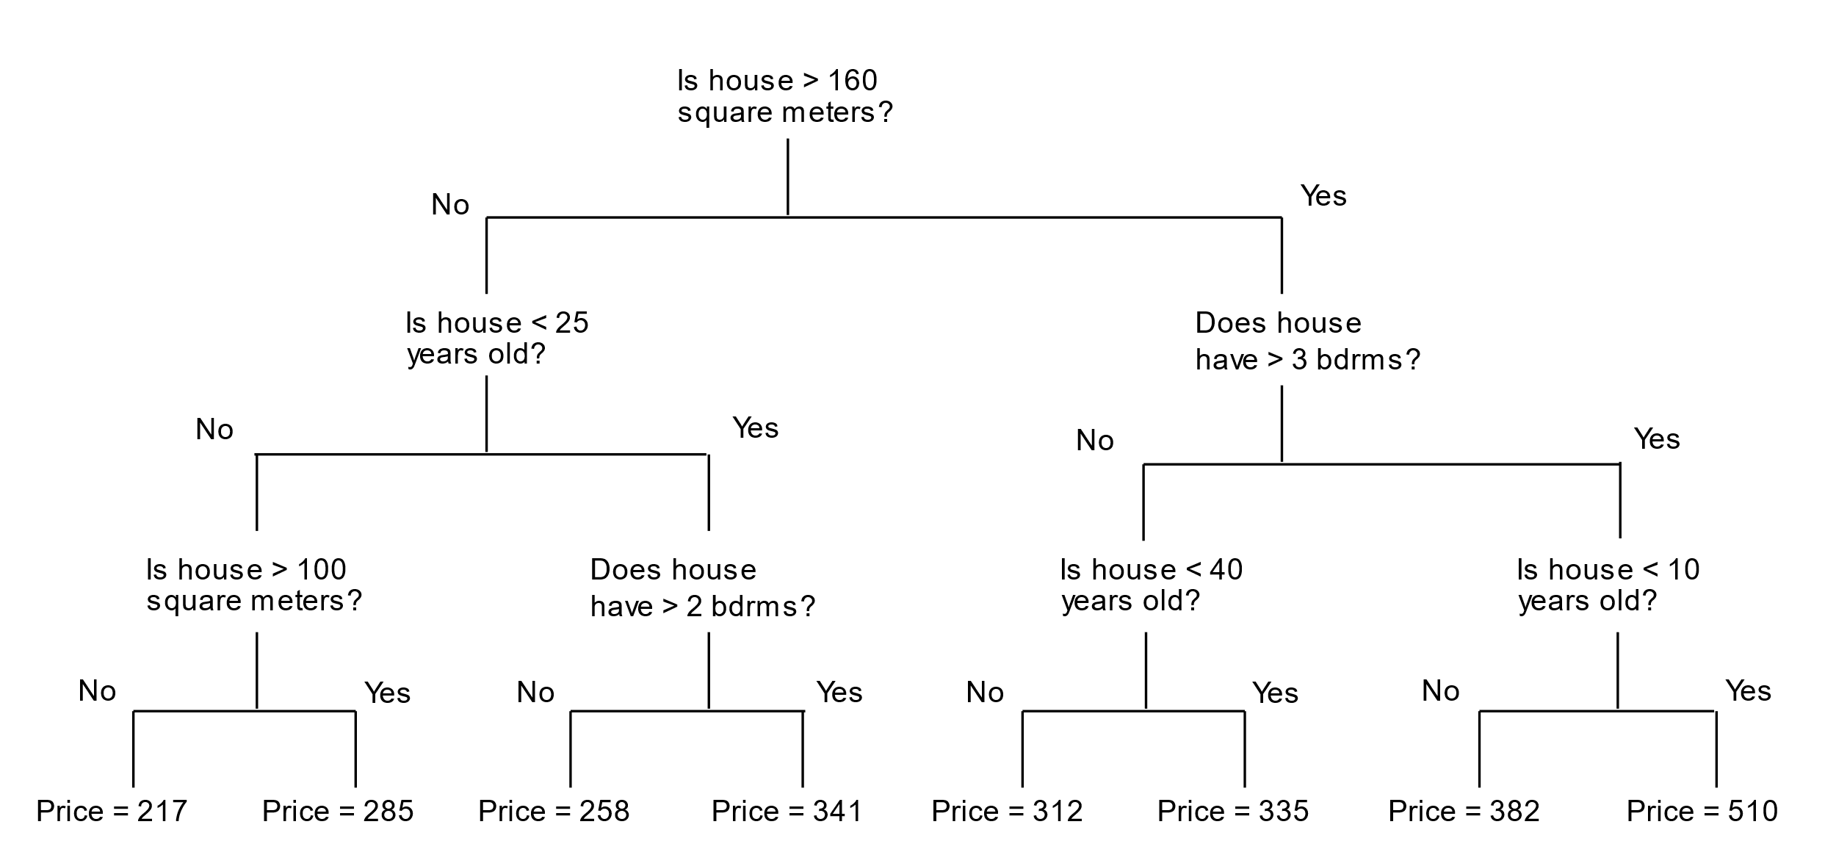
Decision tree

Slide 36
Reference
Machine Learning Glossary
zero-to-mastery-ml
machinelearning-datascience
Hands-On Machine Learning with Scikit-Learn, Keras, and TensorFlow
handson-ml2
scikit-learn: Save and Restore Models
Introduction to Machine Learning Algorithms: Linear Regression

